Slide 1
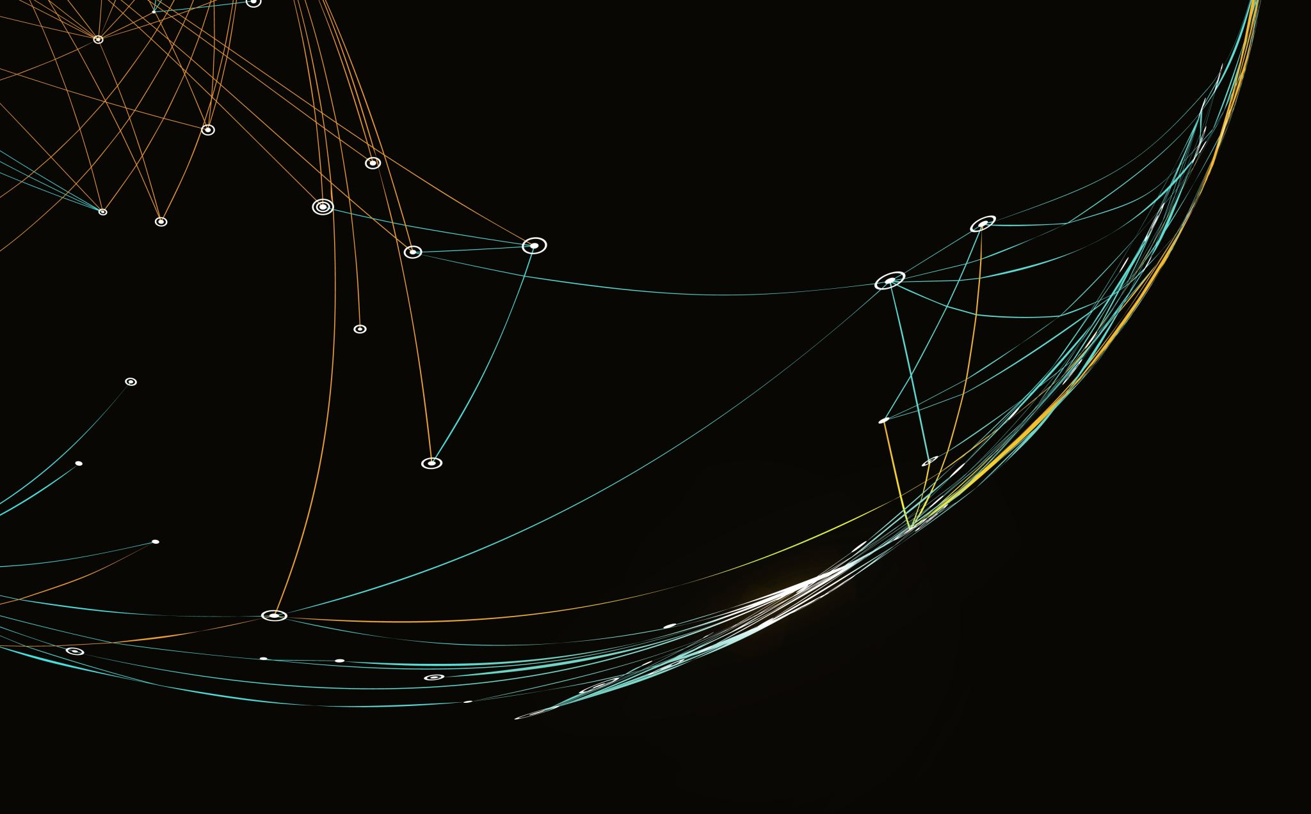
Surfing YouTube
A Video Recommendation ABM

Slide 2
Recommenders
YouTube, Netflix, Amazon – all examples of collaborative filtering technology.
Allows us to parse huge menu of options down to a few.
However – we incur risk of Type I and Type II errors concerning our beliefs in recommenders.
Behavioral economic concerns of addiction, formation of echo chambers, radicalization, etc.

Slide 3
Literature
Algorithmic Overdependence: Banker & Khetani (2019)
“Pandora’s Box” optimal search - Weitzman (1979), Olszewski and Weber (2015).
Olszewski and Weber propose a generalized Pandora’s Rule.

Slide 4
Theory

Slide 5
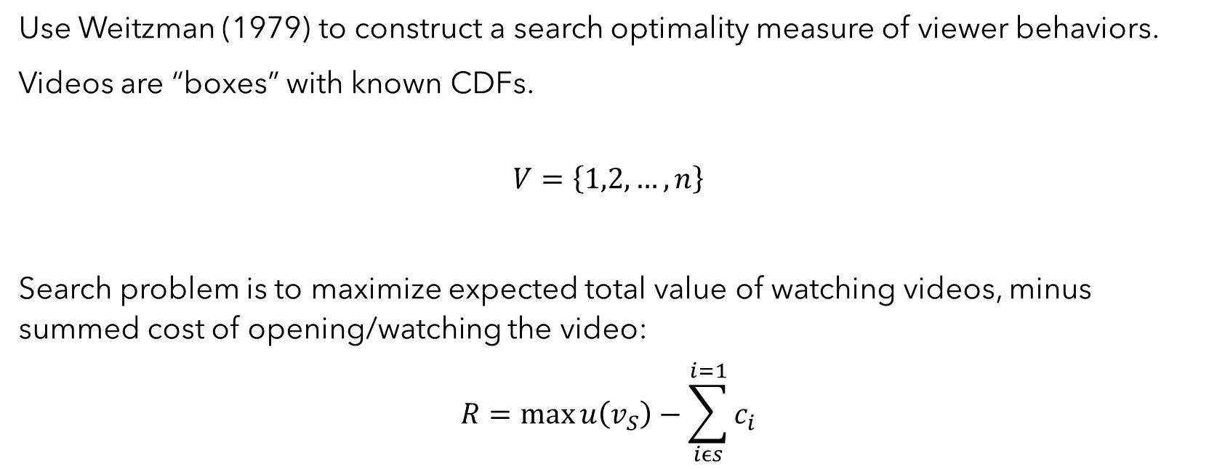
Video Search Problem
Use Weitzman (1979) to construct a search optimality measure of viewer behaviors.
Videos are “boxes” with known CDFs.
$$V=\left\{1,2,…,n\right\}$$
Search problem is to maximize expected total value of watching videos, minus summed cost of opening/watching the video:
$$R=\max{u\left(v_{S}\right)}−\sum_{iϵs}^{i=1}{c_{i}}$$

Slide 6
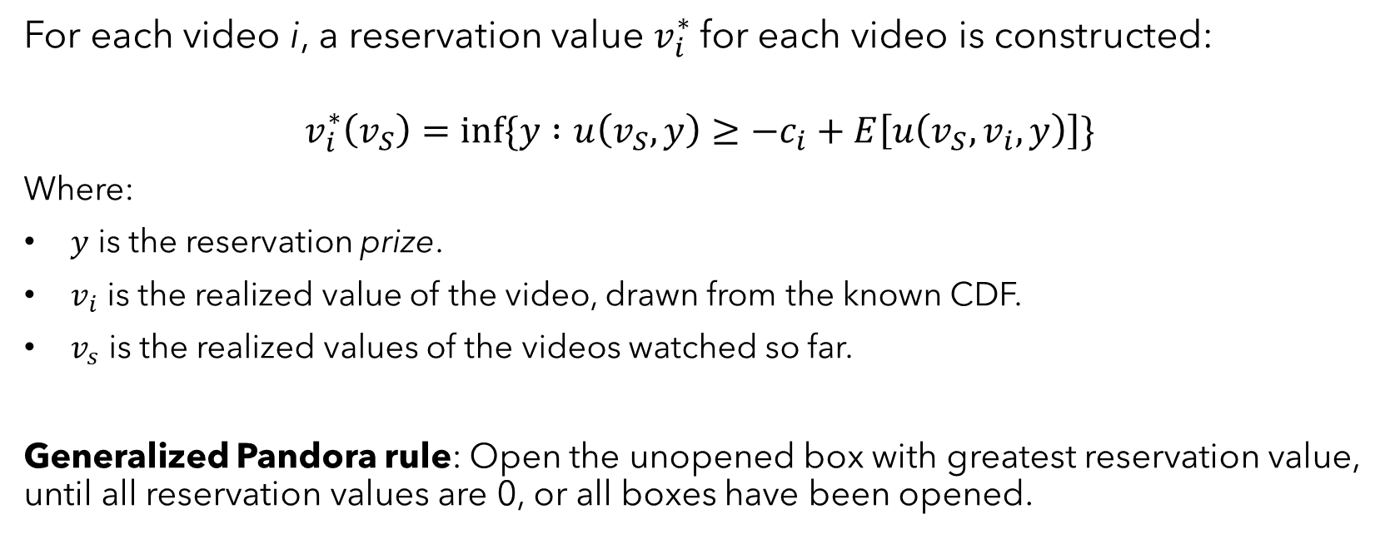
Generalized Pandora’s Rule
For each video i, a reservation value $v_{i}^{∗}$for each video is constructed:
$$v_{i}^{∗}\left(v_{S}\right)=inf⁡\{y :u\left(v_{S}, y\right)≥−c_{i}+E\left[u\left(v_{S},v_{i}, y\right)\right]\}$$
Where:
$y$ is the reservation prize.
$v_{i}$ is the realized value of the video, drawn from the known CDF.
$v_{s}$ is the realized values of the videos watched so far.
Generalized Pandora rule: Open the unopened box with greatest reservation value, until all reservation values are 0, or all boxes have been opened.

Slide 7
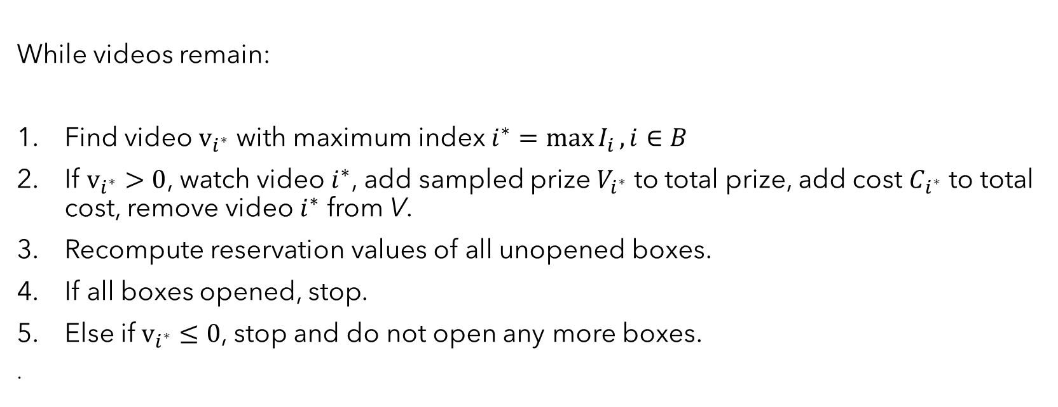
Video Search Problem - Solution
While videos remain:
Find video $v_{i^{∗}}$ with maximum index $i^{∗}=\max{I_{i}}, i∈B$
If $v_{i^{∗}}>0$, watch video $i^{∗}$, add sampled prize $V_{i^{∗}}$ to total prize, add cost $C_{i^{∗}}$ to total cost, remove video $i^{∗}$ from V.
Recompute reservation values of all unopened boxes.
If all boxes opened, stop.
Else if$v_{i^{∗}}≤0$, stop and do not open any more boxes.
.

Slide 8
Model

Slide 9
Model - Design Overview
20x20 grid.
Three types of agents – watchers, mimics, and recommender systems.
“Videos” are boxes with known CDFs randomly placed around the grid.
Recommender assumed to have perfect knowledge of user preferences, i.e., it is a perfect Weitzman solver.
Three “treatments” – high-value, random-value and no-recommend.

Slide 10
Model – Watchers
Watchers have following characteristics:
Memory of past locations and past payoffs.
Payoff “direction” measure.
Number of rounds.
Soft-max “acuity” weights to video expected value.
“Recommender trust.”
Two types: searcher or mimic.

Slide 11
Model – Recommenders
For each agent, recommender system will solve the optimal search problem.
In each round:
- HVT will recommend highest value video to watch.
- RVT will recommend random adjacent video to watch.
- NRT will not recommend any videos.

Slide 12
Model – Procedure (Searchers)
Define watcher, video, and recommender classes.
Initialize model with parameters and place watchers, videos on grid.
Recommender step: generate recommendation for each watcher.
Watcher step: for each watcher, for each round:
Check stopping point.
If Searcher: Move (choose to follow recommendation or not).
If Mimic: Move (choose max-liked video, else move randomly).
Watch video and decide whether to leave a like.
Calculate average payoff and payoff direction.
Model ends – report watcher attributes, final payoffs, and video payoffs.

Slide 13
Analytics

Slide 14




Preliminary Analyses
$$\begin{aligned}&Y_{i}=β_{1}acuity_{i}+ε_{i} \end{aligned}$$
$$Y_{i}=β_{1}acuity_{i}+β_{2}trust_{i}+β_{3}recommender_random+ ε_{i}$$
$$Y_{i}=β_{1}acuity_{i}+β_{2}trust_{i}+β_{3}recommender_random+ ε_{i}$$
$$Y_{i}=β_{1}acuity_{i}+β_{2}trust_{i}+β_{3}recommender_hv+ ε_{i}$$

Slide 15
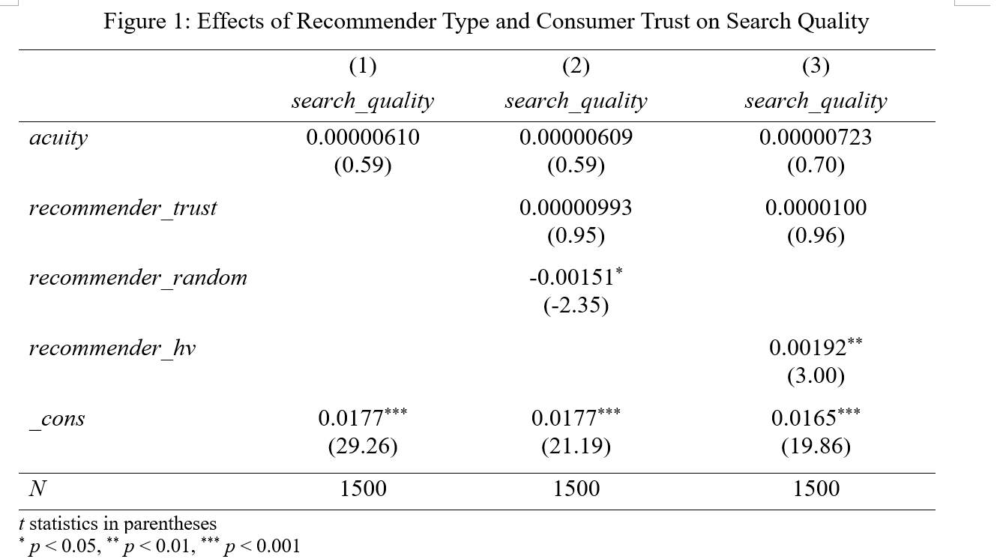
Preliminary Results

Slide 16
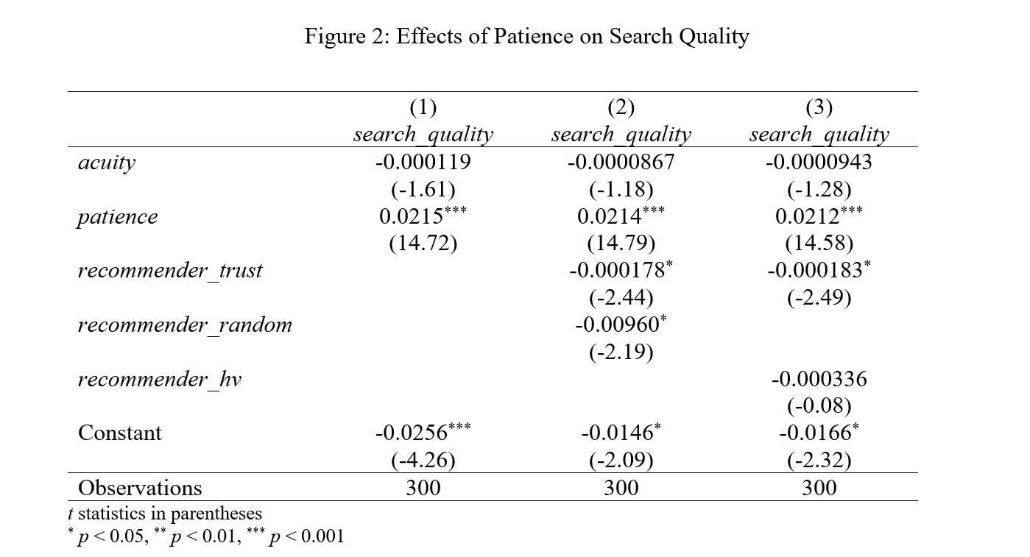
Preliminary Results

Slide 17
Additional Analysis
Searcher types – mimics.
Parameter value search for acuity.

Slide 18
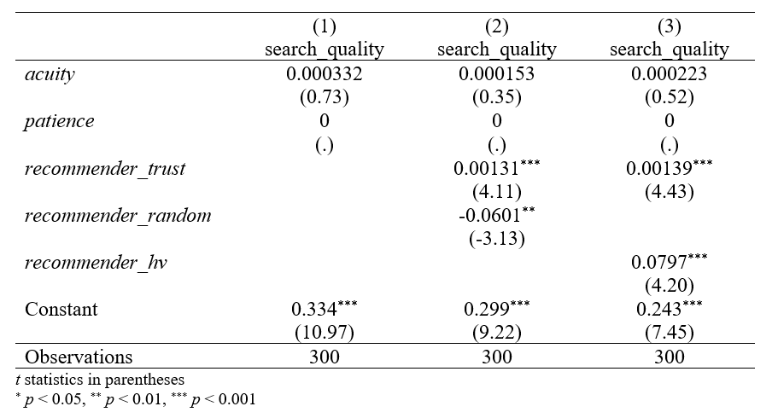
Preliminary Results

Slide 19
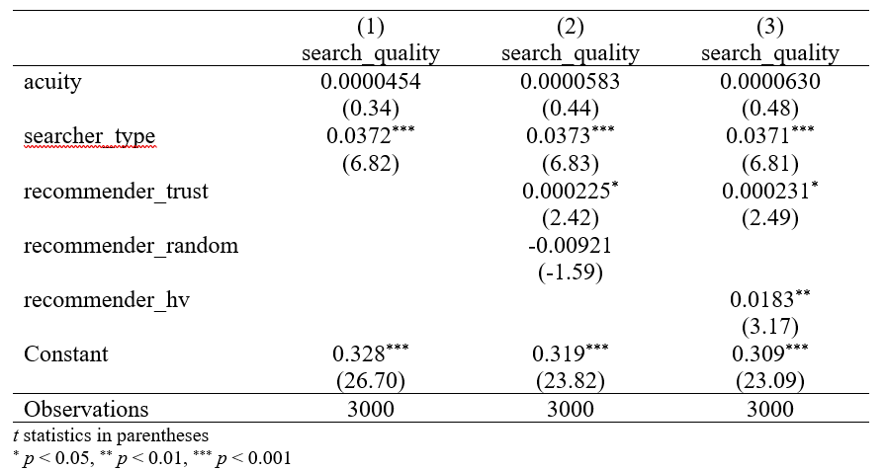
Preliminary Results

Slide 20
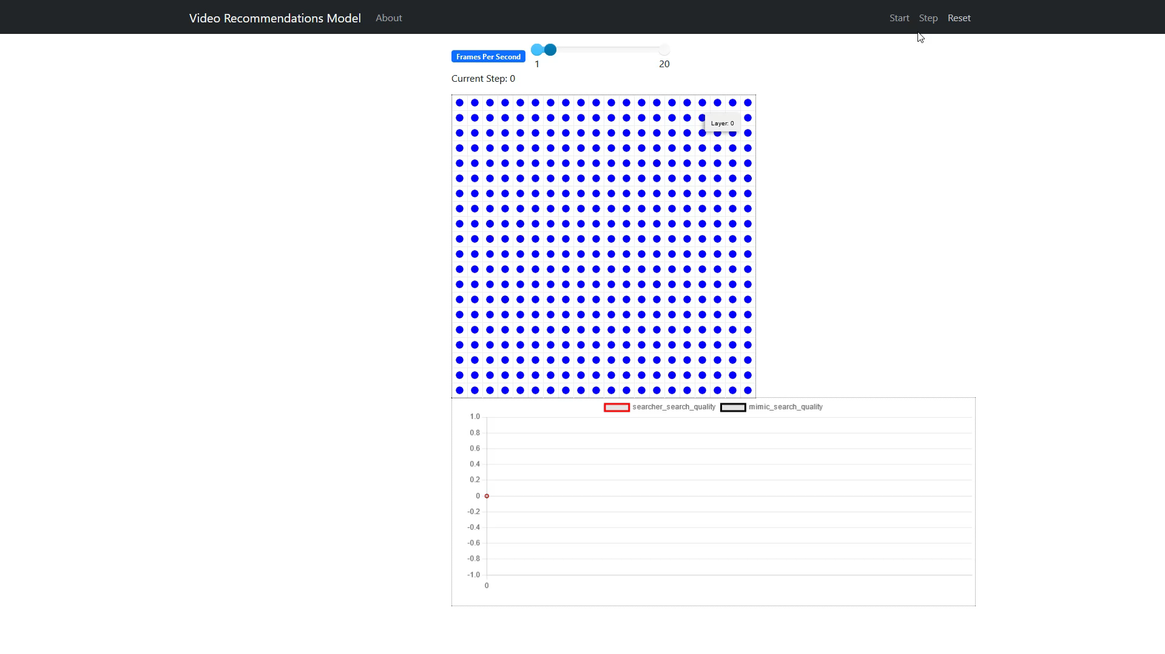
Searchers vs. Mimics Visualization

Slide 21
Results
Interaction effect between acuity and treatment effect.
Mixed evidence against algorithmic overdependence.
Mimics more efficient than active searchers.

Slide 22
Discussion
Need to introduce more interaction between agents.
Generalized Pandora’s Rule.
Testing difference in outcomes of “riskier” videos.
Parameter value search of values of recommender trust, acuity, and searcher/mimic ratio.

